Slide 1
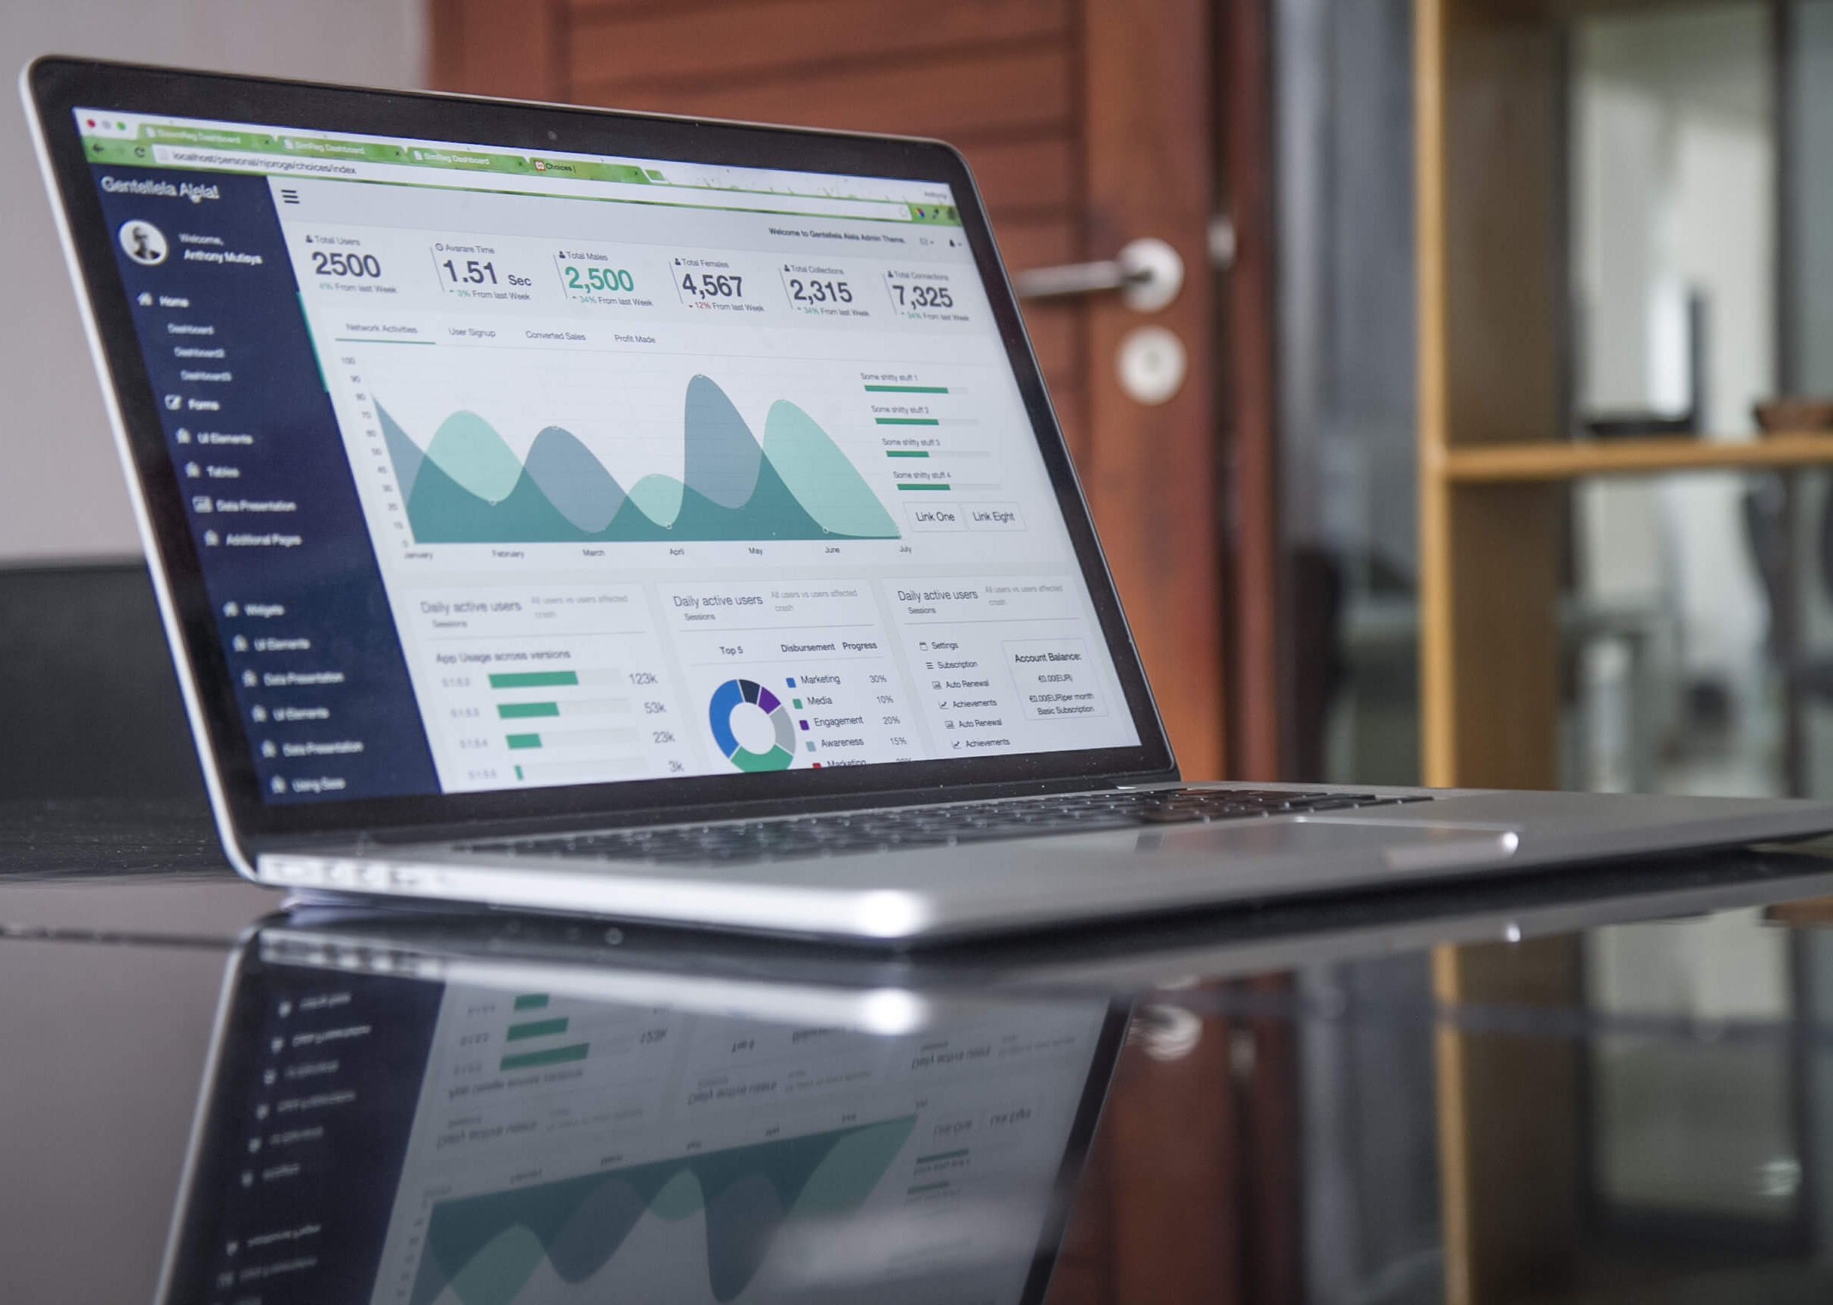
Test scenario for online market software
Faculty of Computers & Informatics
Made by
Mohamed Ahmed Mahmoud
Mazen Amir mohamed
Mohamed Ibrahim mohamed
Mohamed Ashraf mohamed
Marten Naser

Slide 2
content
1
1
objective
use-case diagram
2
Pre-requisites
2
ERD
3
Test steps
4
System requirement & tools

Slide 3
Objective

Slide 4

Objective
to ensure that the software can successfully make orders
In order to ensure that the user gets the best and easiest use experience
To test the functionality and usability of online market app
Faculty of Computers & Informatics

Slide 5
Pre-requisites

Slide 6

Pre-requisites
To use the software the user will need :-
Stable internet connection
A web browser ( chrome , Firefox , safari , etc. )
A valid email address and password for registration
A valid payment method ( credit , debit card , PayPal , etc. )
Faculty of Computers & Informatics

Slide 7
Test steps

Slide 8

Test steps
1. Registration process :-
Open the application URL in a web browser
Click on the “sign up “ button
Enter a valid email address and password
Click on the “ register “ button
Verify that the user is redirected to the home page after successful registration
Faculty of Computers & Informatics

Slide 9
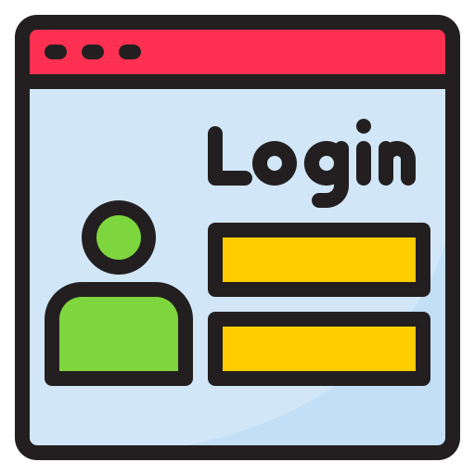
Test steps
2. Login Process :-
Click on the "Login" button
Enter the registered email address and password
Click on the "Login" button
Verify that the user is redirected to the home page after successful login.
Faculty of Computers & Informatics

Slide 10

Test steps
3. Search Product :-
Enter a product name in the search bar
Click on the "Search" button.
Verify that relevant products are displayed in search results..
Faculty of Computers & Informatics

Slide 11
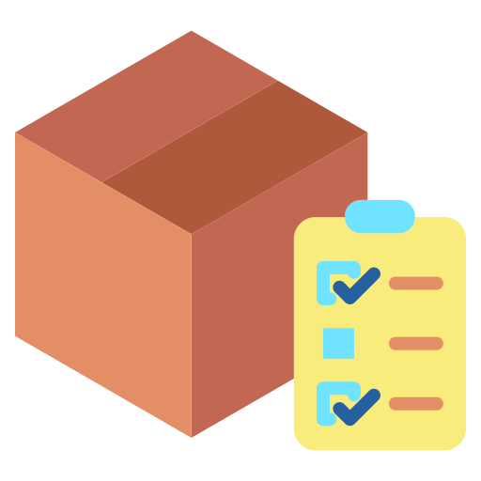
Test steps
4. Product Details :-
Click on any product from search results.
Verify that product details such as name, description, price, and images are displayed correctly.
Faculty of Computers & Informatics

Slide 12

Test steps
5. Add to Cart :-
Select any product from product details page
Click on "Add to Cart" button.
Verify that selected product is added to cart successfully
Faculty of Computers & Informatics

Slide 13

Test steps
6. Checkout Process :-
Click on “Cart” icon
Verify all selected products are listed with correct quantity and price
Click “Checkout” Button
Enter shipping address details
Select payment method
Enter payment details
.Click “Place Order” Button
Verify order confirmation message is displayed

Slide 14

Test steps
7. Order History :-
Click “Order History” tab
Verify all previous orders are listed with correct order number,date,time,status and amount
8. Logout :-
.Click “Logout” Button
Verify user is logged out successfully

Slide 15
System requirement & tools

Slide 16

System requirement & tools
A web designer ( UI / UX )
Web developer
a strong server
Strong security for payment
Strong database
Deals with shipping company and bank account
Sellers and products to sell
Used language : JavaScript , my SQL , PHP

Slide 17
Use-case diagram

Slide 18
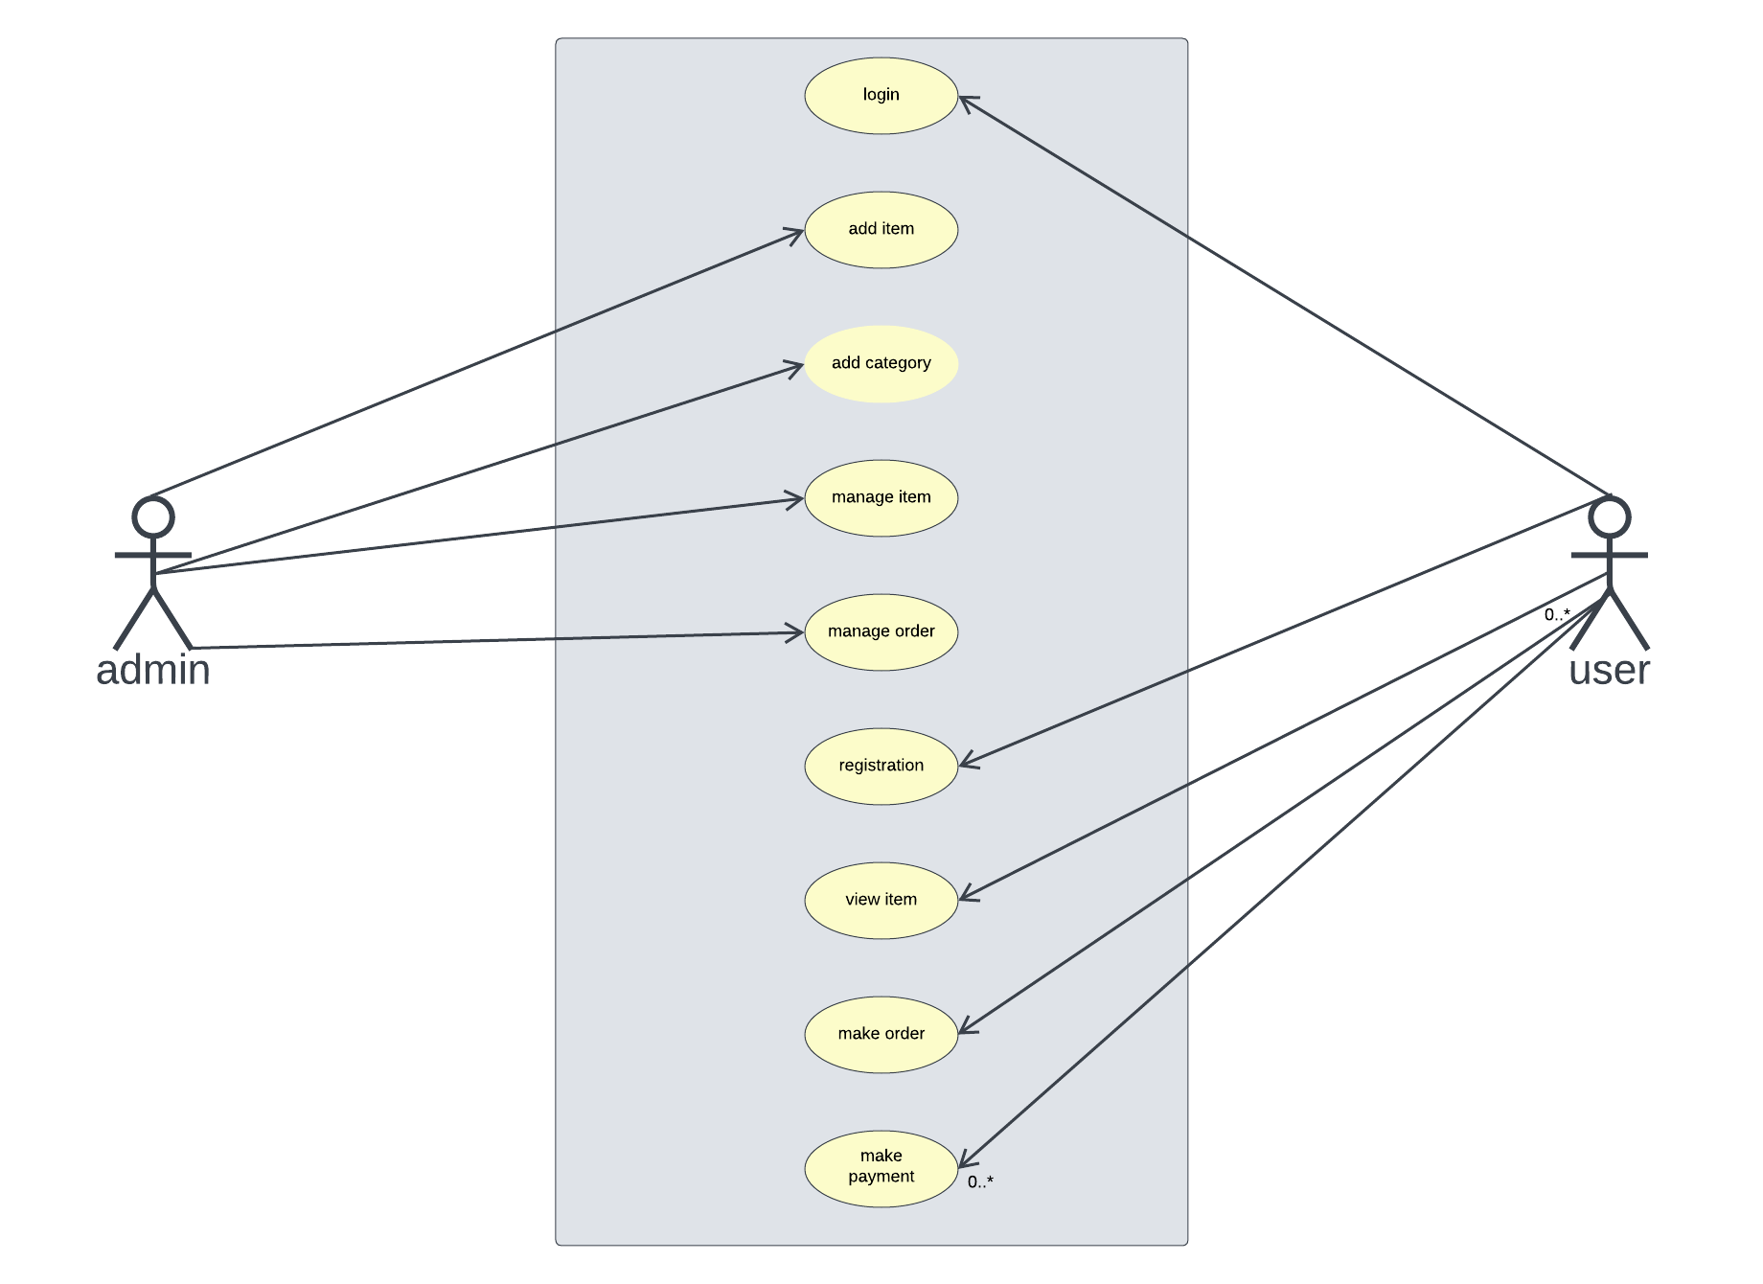

Slide 19
ER-diagram

Slide 20
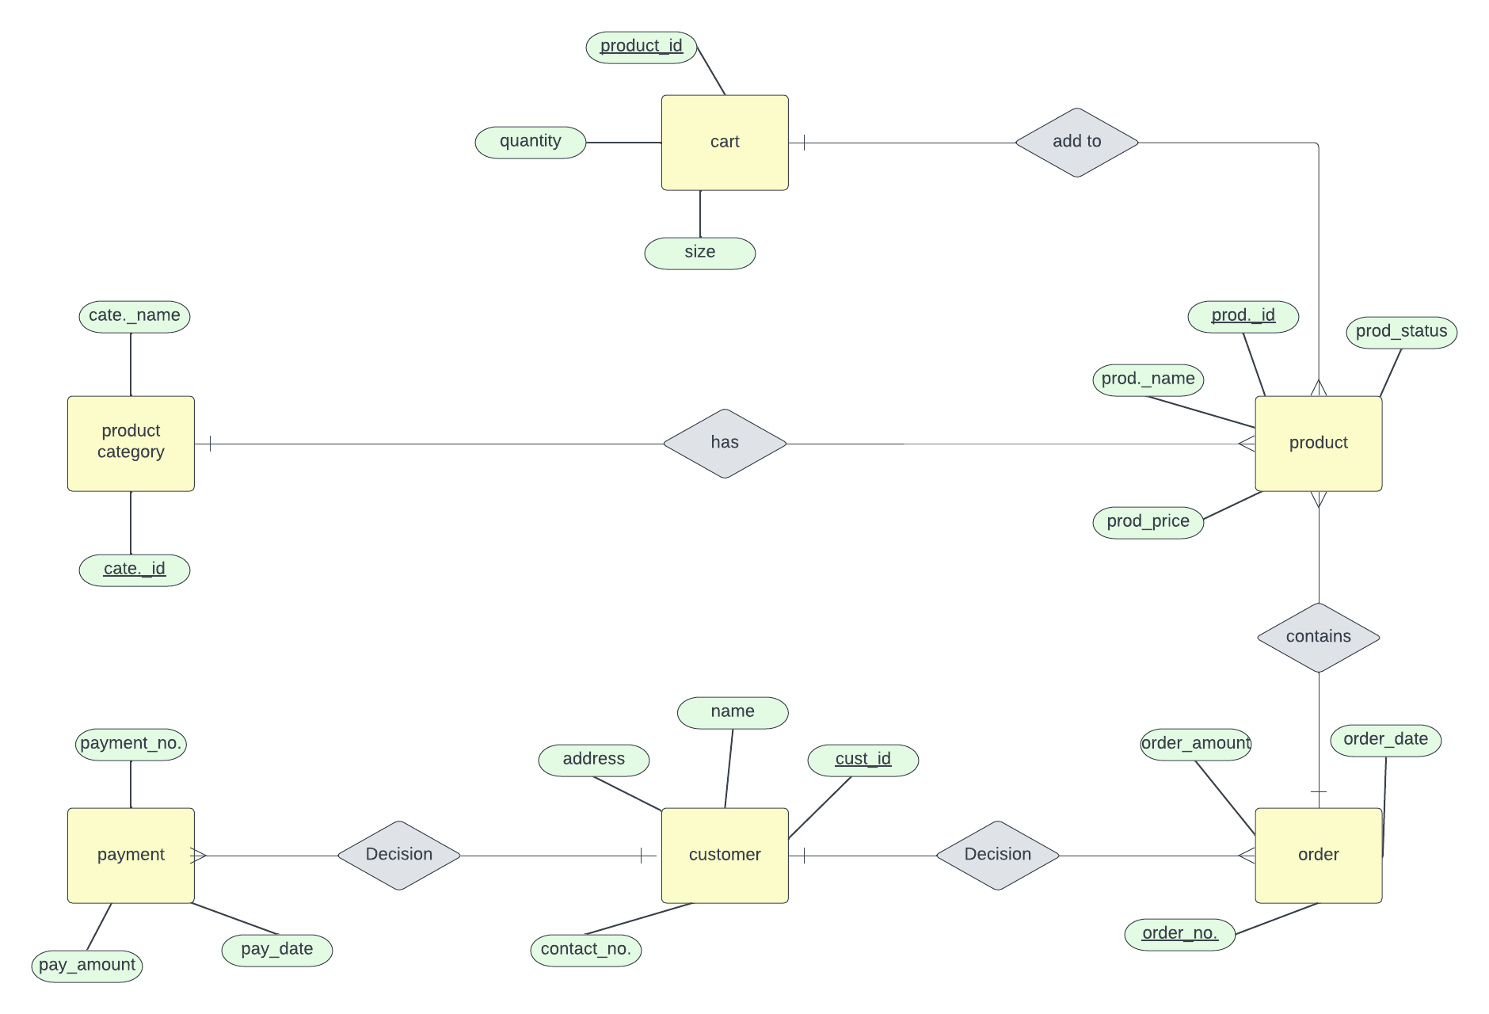

Slide 21
?
Any
questions

Slide 22
Thank you
System analysis & design
Under instruction Dr : Heba / Sameha
Faculty of Computers & Informatics

